Slide 1
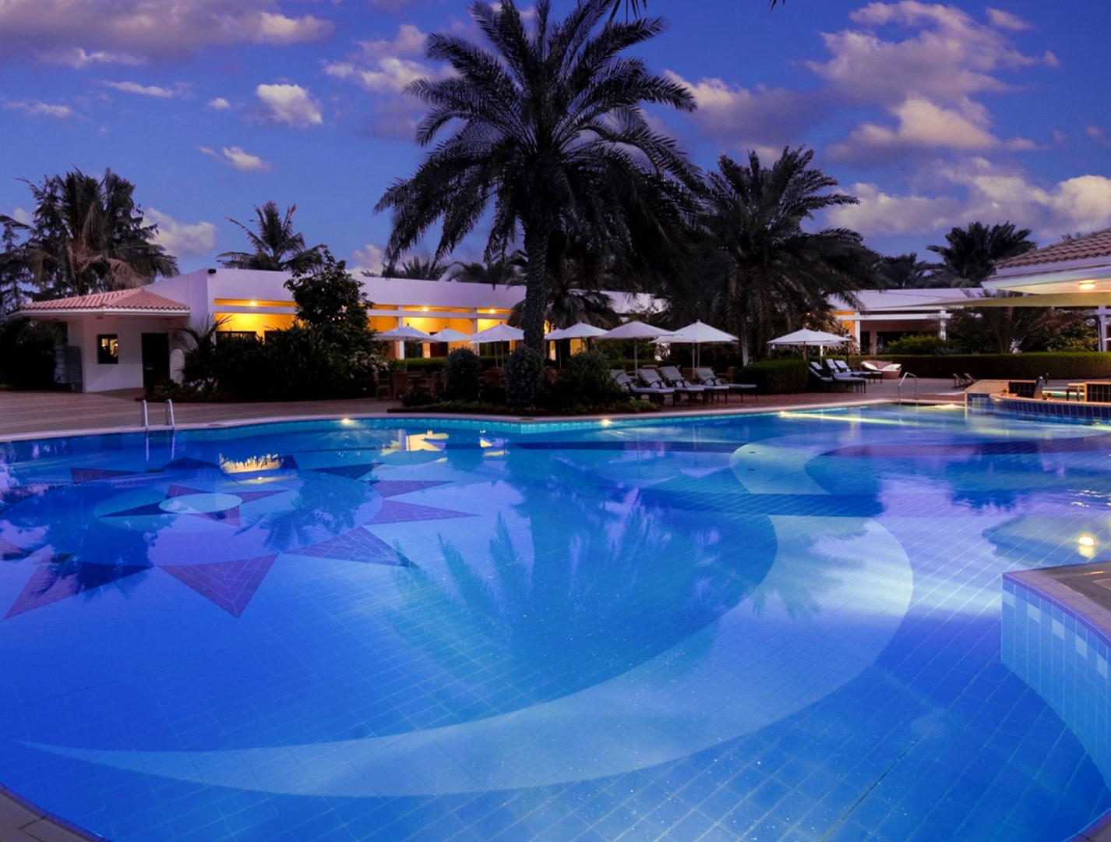
Accommodation
Group 1 (1:00-2:30)

Slide 2

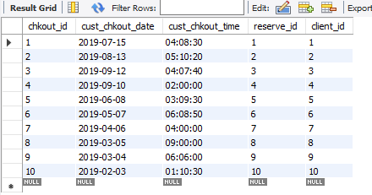
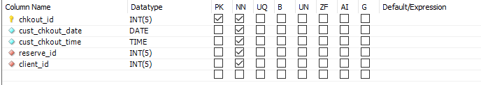
Accommodation
Checkout table from accommodation database

Slide 3
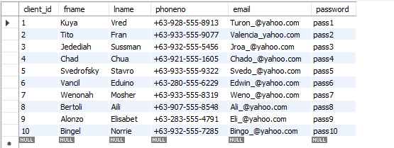
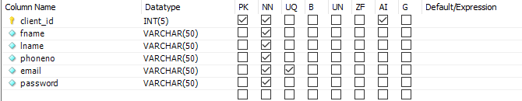
accommodation
Client table from accommodation
Accommodation

Slide 4
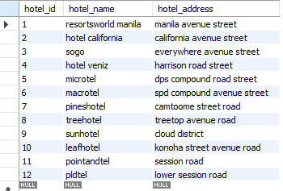
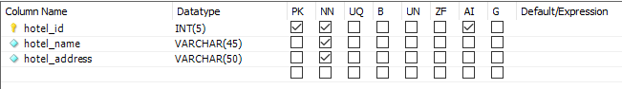
HOTEL table from accommodation
Accommodation
accommodation

Slide 5
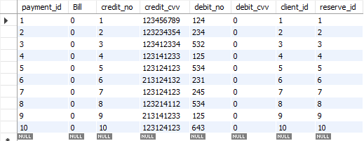
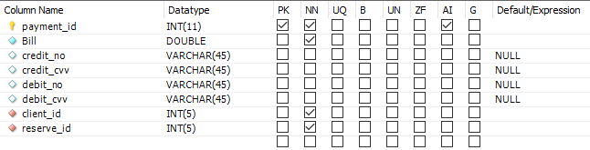
Payment table from accommodation
Accommodation

Slide 6
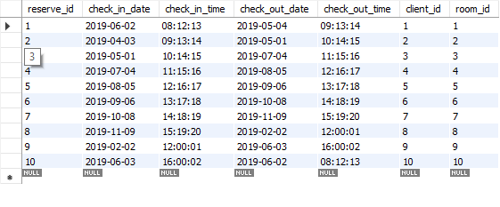
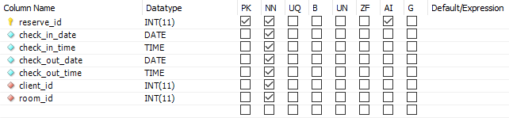
Reservation table from accommodation
Accommodation

Slide 7
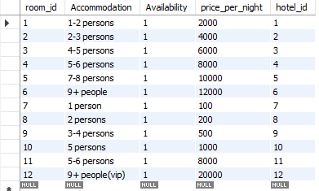
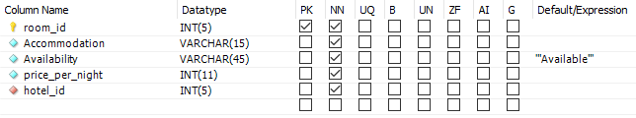
Accommodation
Rooms TABLE FROM ACCOMMODATION​ ​

Slide 8
INSERT JAVA SCREENSHOTS HERE<>

